Slide 1
Adaptive Honeypots: Optimizing Dwell Time with Reinforcement Learning
Using Q-Learning to Adapt Honeypot Lifespan in Real Time
Logan Cadman, June 26th, 2025

Slide 2
Background & Motivation
Why Adaptive Honeypots?
DSCOPE (Pauley, USENIX ’23) is a cloud native internet telescope using short lived honeypots. This type of network telescope receives 73% more traffic than a fixed honeypot.
It uses a fixed 10 minute dwell time, which is chosen for its cost effectiveness.
Eric Pauley's finding were that ~90% of activity occurs within 72 minutes, but most value is seen in the first 10.
Not all networks behave the same.
I propose an Adaptive Honeypot system using a Q-Learning agent to learn optimal dwell time per network context.

Slide 3
Hypothesis & Objective
Is 10 Minutes Enough?
Hypothesis: In certain cases valuable data will continue to arrive after 10 minutes from:
Delayed or reactive scanners and low frequency attack patterns.
Objective: Design a system that learns the optimal dwell time for each deployment using:
Real time network context (state information).
A Q-Learning agent that balances reward (value of data) with cost (wasted resources).

Slide 4
Project Design & Q-Agent
Q-Learning for Adaptive Dwell Time Selection
The system uses a tabular Q-Learning agent to adaptively choose honeypot dwell times.
Each sessions consists of:
Launching a honeypot instance on Google Cloud (GCP).
Capturing TCP_SYN traffic with tcpdump.
Shutting down the instance and retrieve logs.
Extracting state features (e.g. connection rate, unique IP’s, attack sustainability).
Computing reward based on threat score and duration penalty.
Updating agent Q-Table to reinforce dwell time performance in that network context.

Slide 5
Deployment Testbeds
Testbeds: FABRIC vs. Google Cloud
FABRIC Testbed
Initial deployment was on the FABRIC research testbed
Instances were behind a bastion host, limiting inbound connections
Result: Little to no attacker traffic, the agent favored short dwell times ~2 minutes
Limited external visibility resulted in poor training
Google Cloud (GCP)
Switched to Google Cloud for public IP exposure and recycled IP addresses
Configured with automatic firewall rules, instance tagging, and tcpdump logging
Result: Rich attack traffic, diverse scanning behavior, and delayed connections
Enabled the agent to learn meaningful context reward relationships

Slide 6
Results & Observations
Results: Learning to Adapt Dwell Time
The Q-Agent assigned higher values to longer dwell times (> 10 minutes).
After expanding the action space, 45 minute durations showed the highest Q-Value, beating 60 minutes and 30 minutes.
Evidence suggests that significant attacker behavior occurs after 10-20 minutes.
Top dwell times:
45 min -> Q-Value = 11.91
60 min -> Q-Value = 10.48
30 min -> Q-Value = 6.90
Shorter durations 0-10 minutes, consistently lower reward, especially in rich traffic environments.
The agent adapted its behavior based on traffic richness and sustainability.
This data suggests that static 10 minute dwell times may miss valuable traffic information.

Slide 7
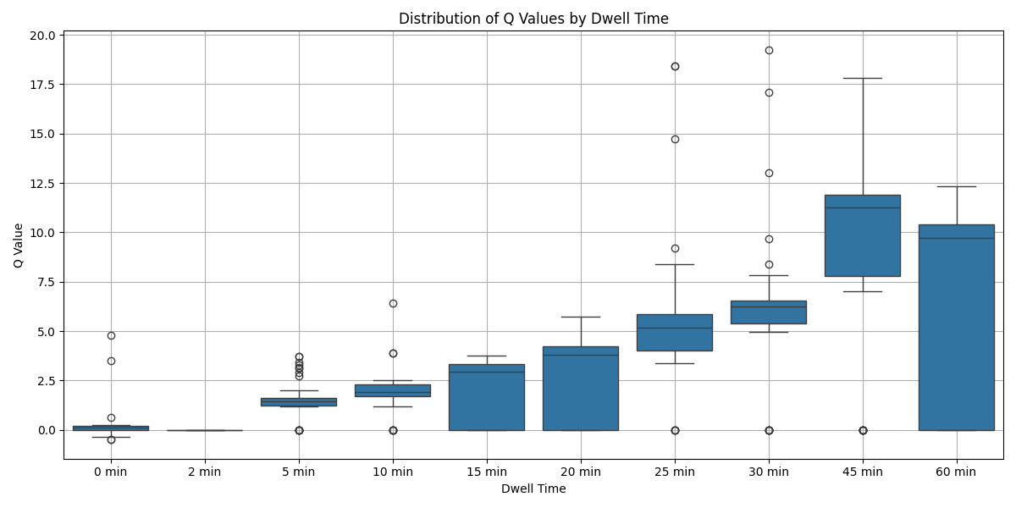
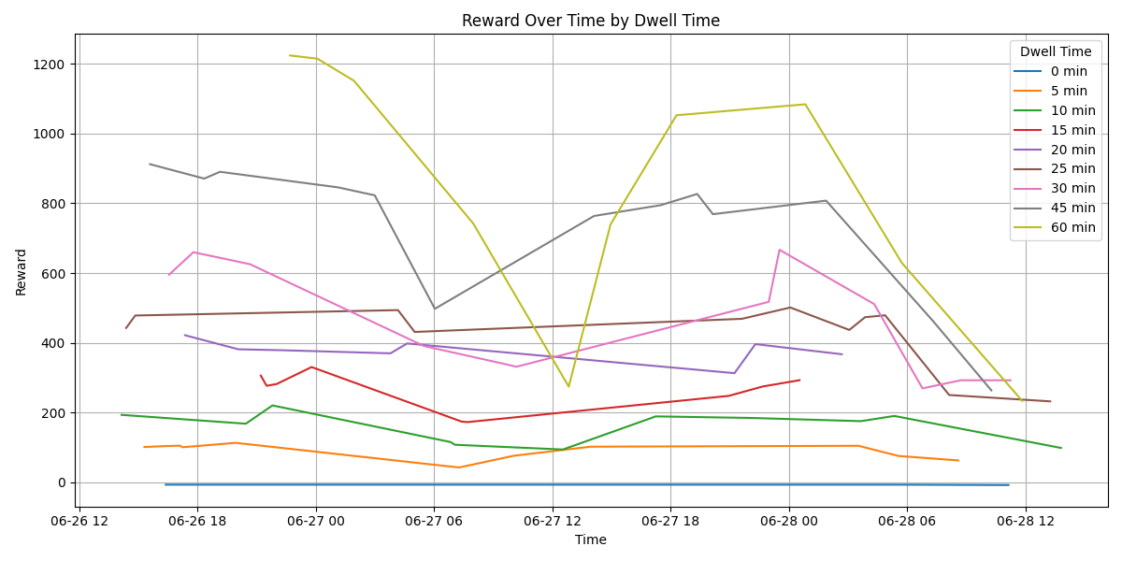
Results Continued

Slide 8
Conclusion
Key Findings from Adaptive Honeypots
Static dwell times (e.g. 10 minutes) may prematurely terminate valuable honeypot sessions
My Adaptive Honeypot system uses Q-Learning to select context aware dwell times based on network behavior
In rich traffic environments like Google Cloud, the agent favored 45 minute dwell times
This supports the hypothesis that valuable traffic persists well beyond the 10 minute window

Slide 9
Questions? Thank you!

